Slide 1


Dynamic Memory Allocation
Nazrin Dolkhanova Sultanli
Programming and Computer Applications – 1

Slide 2



Agenda
Introduction
malloc()
calloc()
realloc()
allocation of 2d array
free()
malloc() vs calloc()
realloc() security problems

Slide 3
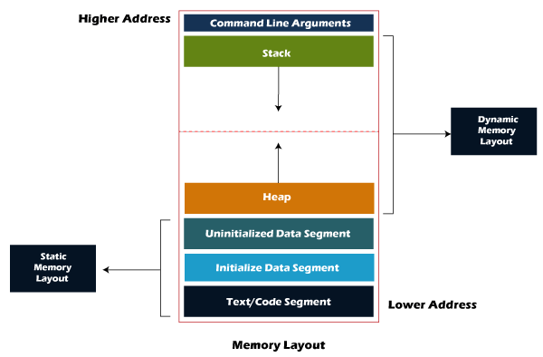
Introduction
Memory Layout
When C program is executed, the executable code of the file loads into RAM in an organized manner. Computers do not access program instructions directly from secondary storage because the access time of secondary storage is longer when compared to that of RAM. RAM is faster than secondary storage but has a limited storage capacity, so it is necessary for programmers to utilize this limited storage efficiently.
Components of C program memory layout:
Command-line arguments
Text/code segment.
Data section
Uninitialized data
Initialized data
Stack
Heap
Each of these segments has its own read, write permissions. A segmentation fault occurs when a program tries to access any of the segments in a way that is not allowed, which is also a common reason for the program to crash.
Notes:
https://www.scaler.com/topics/c/memory-layout-in-c/
https://www.geeksforgeeks.org/memory-layout-of-c-program/
https://www.javatpoint.com/memory-layout-in-c

Slide 4
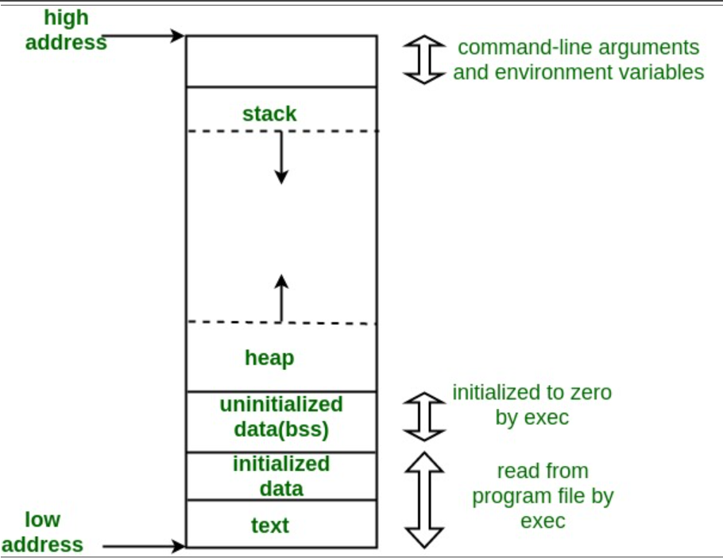
Introduction
Memory Layout
1. Command-line arguments
The arguments passed from command line are called command line arguments. These arguments are handled by main() function.
To support command line argument, you need to change the structure of main() function as given below.
int main(int argc, char *argv[] )
Here, argc counts the number of arguments. It counts the file name as the first argument.
The argv[] contains the total number of arguments. The first argument is the file name always.
3. Data section
The data which is used in our program will be stored in the data section. Since the variables declared inside the main() function are stored in the stack, but the variables declared outside the main() method will be stored in the data section. The variables declared in the data section could be stored in the form of initialized, uninitialized
2. Text segment
The text segment is also known as the code segment. When we compile any program, it creates an executable file like a.out, .exe, etc., that gets stored in the text or code section of the RAM memory.
If the instructions are store in the hard disk, then the speed for accessing the instructions from the hard disk becomes slower.
Notes:
#include<stdio.h>
int main(int argc, char *argv[]) {
int i;
// first value in argv stores file name
printf("File name = %s\n", argv[0]);
printf("Number of arguments passed = %d\n", argc-1);
for(i = 1; i < argc; i++) {
printf("Value of Argument_%d = %s\n", i, argv[i]);
}
return 0;
}

Slide 5
Introduction
3. Data Section
b) Initialized data segment
An initialized data segment is also known as the data segment. A data segment is a virtual address space of a program that contains all the global and static variables which are explicitly initialized by the programmer.
The values of variables in a data segment are not read-one, i.e., they can be modified at run time. This data segment can be further classified into categories:
Initialized read-only area: It is an area where the values of variables cannot be modified.
Initialized read-write area: It is an area where the values of variables can also be altered.
For example: the global variables like char str[] = "javatpoint" and int a=45; will be stored in the initialized read-write area. If we create the global variable like const char* string = "javatpoint"; the literal "javatpoint" would be stored in the initialized read area, whereas the char pointer variable would be stored in the initialized write area.
Memory Layout
3. Data Section
a) Uninitialized data segment
The uninitialized data segment is also known as a .bss segment that stores all the uninitialized global, local and external variables. If the global, static and external variables are not initialized, they are assigned with zero value by default.
The .bss segment stands for Block Started by symbol. The bss segment contains the object file where all the statically allocated variables are stored. Here, statically allocated objects are those objects without explicit initialization are initialized with zero value. In the above code, var1 is an uninitialized variable so it is stored in the uninitialized data section.
#include<stdio.h>
char string[] = "javatpoint"; // global variable stored in initialized
//data segment in read-write area..
int main()
{
static int i = 90; // static variable stored in initialized data segment..
return 0;
}
#include<stdio.h>
char a; // uninitialized global variable..
int main()
{
static int a; // uninitialized static variable..
return 0;
}
Notes:
#include<stdio.h>
int main(int argc, char *argv[]) {
int i;
// first value in argv stores file name
printf("File name = %s\n", argv[0]);
printf("Number of arguments passed = %d\n", argc-1);
for(i = 1; i < argc; i++) {
printf("Value of Argument_%d = %s\n", i, argv[i]);
}
return 0;
}

Slide 6
Introduction
Memory Layout
4. Stack
The stack area traditionally adjoined the heap area and grew in the opposite direction; when the stack pointer met the heap pointer, free memory was exhausted.
When we define a function and call that function then we use the stack frame. The variables which are declared inside the function are stored in the stack. The function arguments are also stored in the function as the arguments are also a part of the function. Such a type of memory allocation is known as static memory allocation because all the variables are defined in the function, and the size of the variables is also defined at the compile time. The stack section plays a very important role in the memory because whenever the function is called, a new stack frame is created.
Stack is also used for recursive functions. When the function is called itself again and again inside the same function which causes the stack overflow condition and it leads to the segmentation fault error in the program.
5. Heap
Heap memory is used for the dynamic memory allocation. Heap memory begins from the end of the uninitialized data segment and grows upwards to the higher addresses. The malloc(), realloc and calloc() functions are used to allocate the memory in the heap. The heap memory can be used by all the shared libraries and dynamically loaded modules. The free() function is used to deallocate the memory from the heap.
#include<stdio.h>
void foo() {
// local variables stored in stack when the function call is made
int a, b;
}
int main() {
// local variables stored in stack
int local = 5;
char name[26];
foo();
// ..
return 0;
}
#include <stdio.h>
int main() {
// memory allocated in heap segment
char *var = (char*) malloc ( sizeof(char) );
// ..
return 0;
}
Notes:
#include<stdio.h>
int main(int argc, char *argv[]) {
int i;
// first value in argv stores file name
printf("File name = %s\n", argv[0]);
printf("Number of arguments passed = %d\n", argc-1);
for(i = 1; i < argc; i++) {
printf("Value of Argument_%d = %s\n", i, argv[i]);
}
return 0;
}

Slide 7

Topic six
Dynamic Memory Allocation

Slide 8
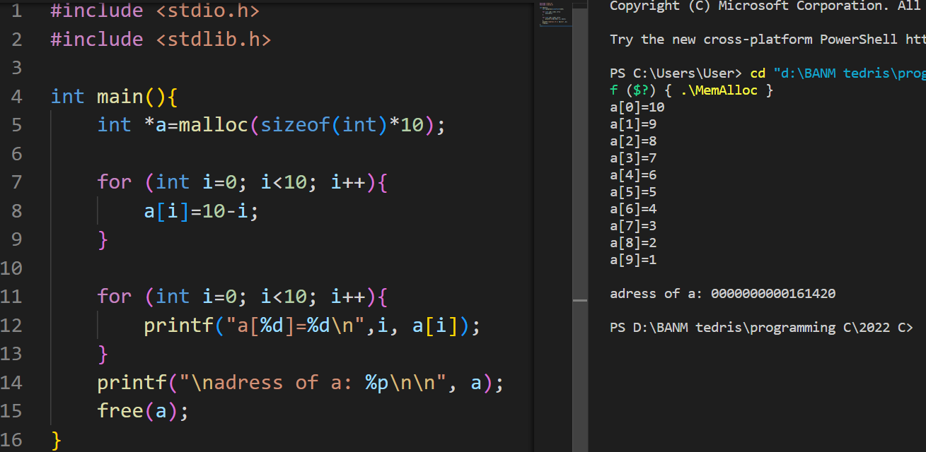
6.1 malloc()
The name "malloc" stands for memory allocation.
The malloc() function reserves a block of memory of the specified number of bytes. And, it returns a pointer of void which can be casted into pointers of any form. It doesn't initialize memory at execution time, so it has garbage value initially.
ptr = (castType*) malloc(size);
ptr = (float*) malloc(100 * sizeof(float));
The above statement allocates 400 bytes of memory. It's because the size of float is 4 bytes. And, the pointer ptr holds the address of the first byte in the allocated memory.
The expression results in a NULL pointer if the memory cannot be allocated.
Notes:
#include <stdio.h>
#include <stdlib.h>
int main(){
int *a=malloc(sizeof(int)*10);
for (int i=0; i<10; i++){
a[i]=10-i;
}
for (int i=0; i<10; i++){
printf("a[%d]=%d\n",i, a[i]);
}
printf("\nadress of a: %p\n\n", a);
free(a);
}

Slide 9
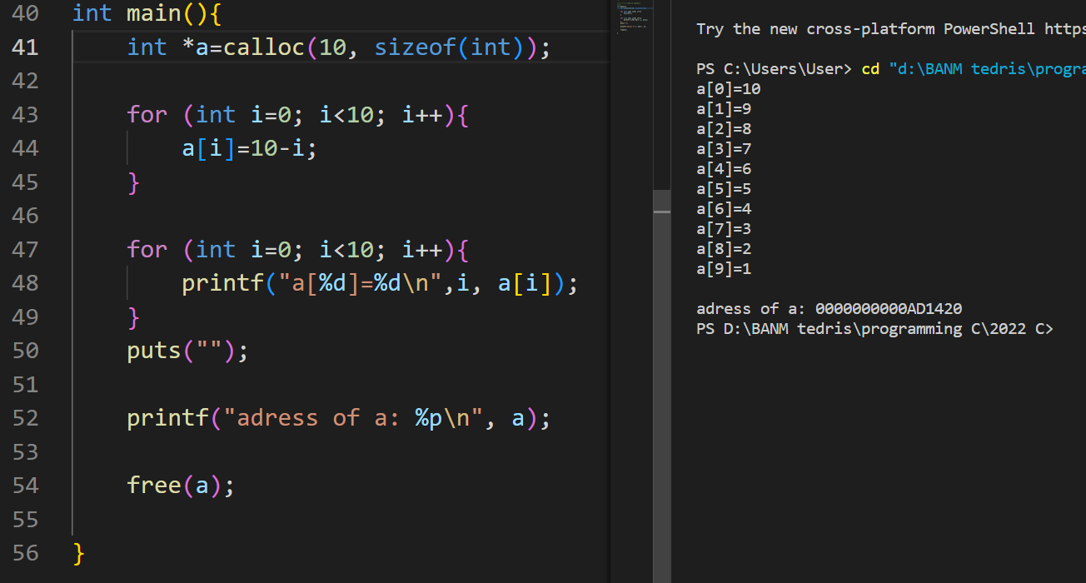
6.2 calloc()
The name "calloc" stands for contiguous allocation.
The malloc() function allocates memory and leaves the memory uninitialized, whereas the calloc() function allocates memory and initializes all bits to zero.
ptr = (castType*) calloc(n, size);
ptr = (float*) calloc(25, sizeof(float));
The above statement allocates contiguous space in memory for 25 elements of type float.
It returns NULL if memory is not sufficient.
Notes:
int main(){
int *a=calloc(10, sizeof(int));
for (int i=0; i<10; i++){
a[i]=10-i;
}
for (int i=0; i<10; i++){
printf("a[%d]=%d\n",i, a[i]);
}
puts("");
printf("adress of a: %p\n", a);
free(a);
}

Slide 10
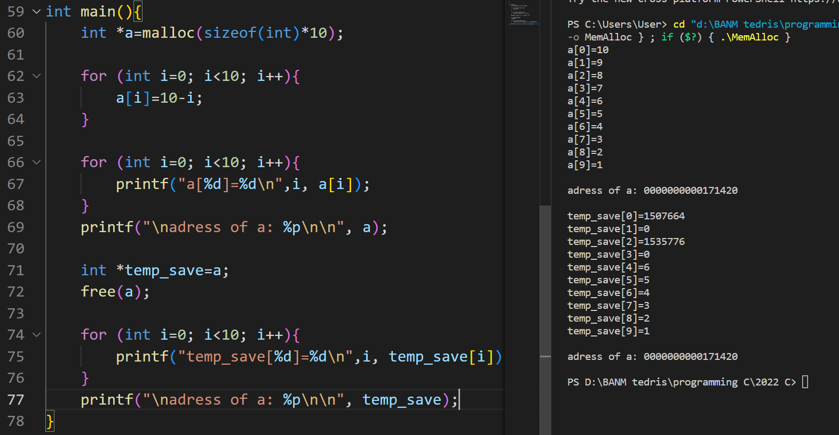
6.3 free()
void mem(){
int *p=malloc(sizeof(int)*12800);
}
int main(){
while(1) {
mem()
};
}
Dynamically allocated memory created with either calloc() or malloc() doesn't get freed on their own. You must explicitly use free() to release the space. Otherwise, it will consume memory until program exit.
free(ptr);
This statement frees the space allocated in the memory pointed by ptr.
When you run a code above, your program will crush and it will ruin your memory.
free(ptr) frees up the block of memory so that it could be allocated again, it means that malloc() and calloc() could use that space.
However, it does not delete the data in that space.
Use free(ptr) to make memory available to be allocated again.
So, calloc() gets the certain memory block and set them to zero. This decreases the security risks (passwords and so on)
This statement frees the space allocated in the memory pointed by ptr.
Notes:
int main(){
int *a=malloc(sizeof(int)*10);
for (int i=0; i<10; i++){
a[i]=10-i;
}
for (int i=0; i<10; i++){
printf("a[%d]=%d\n",i, a[i]);
}
printf("\nadress of a: %p\n\n", a);
int *temp_save=a;
free(a);
for (int i=0; i<10; i++){
printf("temp_save[%d]=%d\n",i, temp_save[i]);
}
printf("\nadress of a: %p\n\n", temp_save);
}

Slide 11
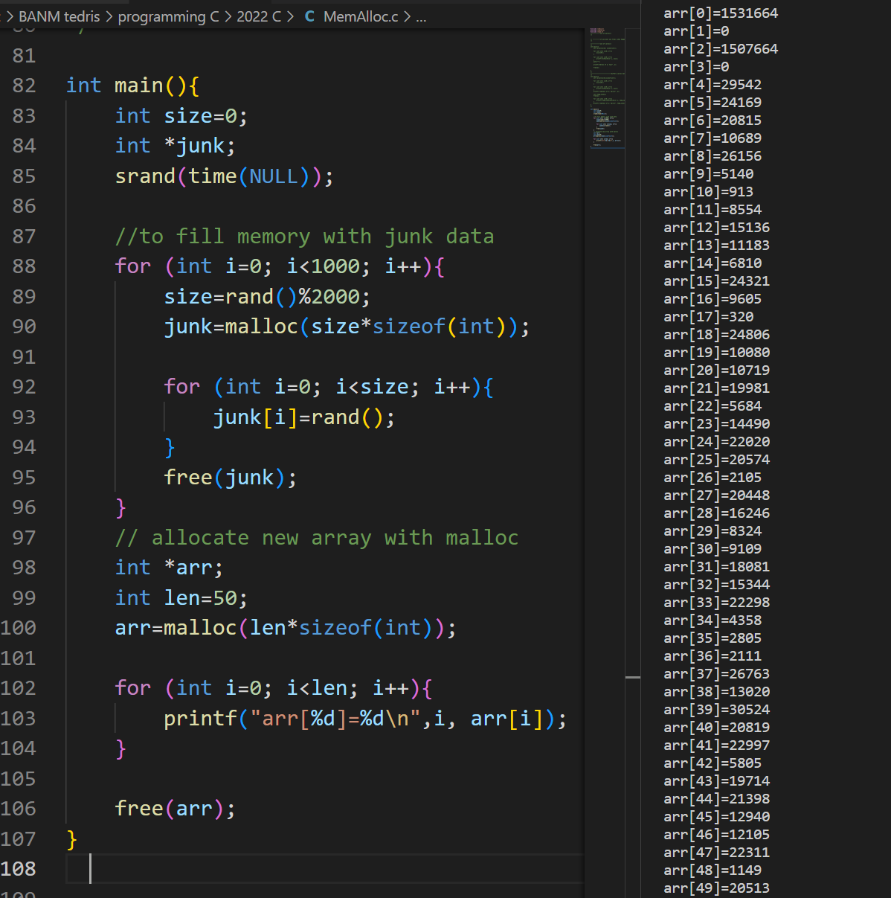
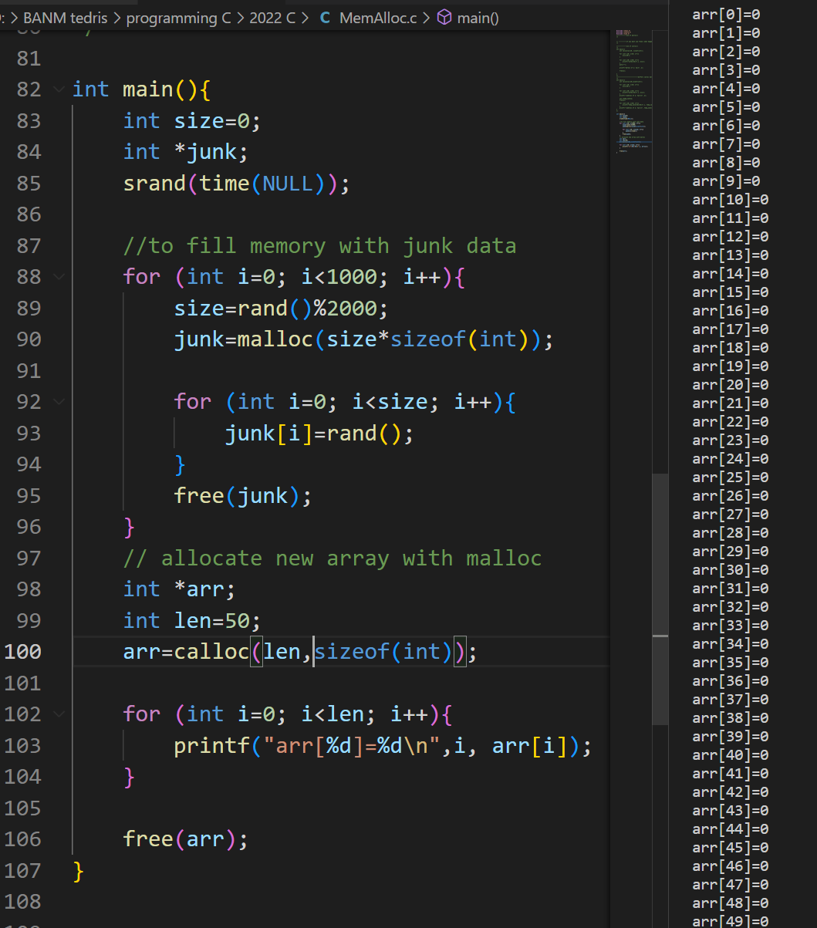
6.4 malloc() vs calloc()
Notes:
int main(){
int size=0;
int *junk;
srand(time(NULL));
//to fill memory with junk data
for (int i=0; i<1000; i++){
size=rand()%2000;
junk=malloc(size*sizeof(int));
for (int i=0; i<size; i++){
junk[i]=rand();
}
free(junk);
}
// allocate new array with malloc
int *arr;
int len=50;
arr=calloc(len,sizeof(int));
for (int i=0; i<len; i++){
printf("arr[%d]=%d\n",i, arr[i]);
}
free(arr);
}

Slide 12
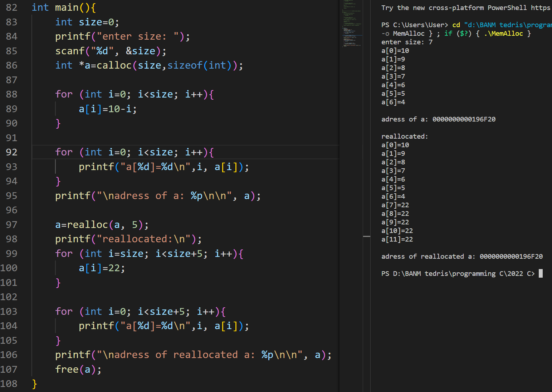
6. 5 realloc()
If the dynamically allocated memory is insufficient or more than required, you can change the size of previously allocated memory using the realloc() function. In short, it changes the memory size.
ptr = realloc(ptr, x);
Here, ptr is reallocated with a new size x.
Notes:
int main(){
int size=0;
printf("enter size: ");
scanf("%d", &size);
int *a=calloc(size,sizeof(int));
for (int i=0; i<size; i++){
a[i]=10-i;
}
for (int i=0; i<size; i++){
printf("a[%d]=%d\n",i, a[i]);
}
printf("\nadress of a: %p\n\n", a);
a=realloc(a, 5);
printf("reallocated:\n");
for (int i=size; i<size+5; i++){
a[i]=22;
}
for (int i=0; i<size+5; i++){
printf("a[%d]=%d\n",i, a[i]);
}
printf("\nadress of reallocated a: %p\n\n", a);
free(a);
}

Slide 13
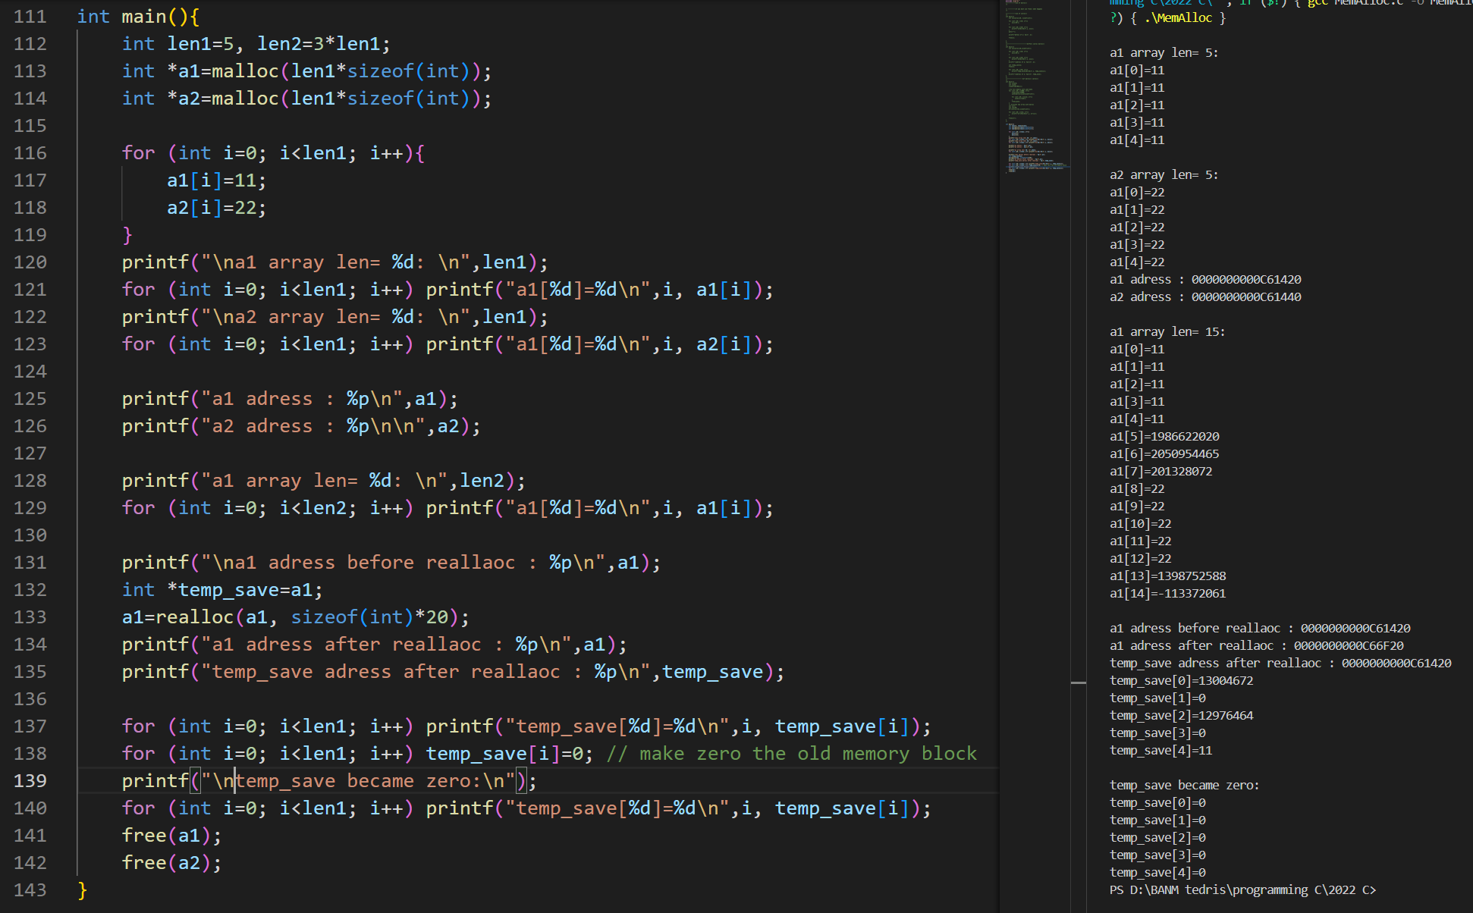
6. 6 realloc() security problems
Data in previously allocated memory has not been changed during realloc() function.
If available, realloc() allocates the next memory blocks, if not, it finds new address for reallocation with a new size.
Notes:
int main(){
int len1=5, len2=3*len1;
int *a1=malloc(len1*sizeof(int));
int *a2=malloc(len1*sizeof(int));
for (int i=0; i<len1; i++){
a1[i]=11;
a2[i]=22;
}
printf("\na1 array len= %d: \n",len1);
for (int i=0; i<len1; i++) printf("a1[%d]=%d\n",i, a1[i]);
printf("\na2 array len= %d: \n",len1);
for (int i=0; i<len1; i++) printf("a1[%d]=%d\n",i, a2[i]);
printf("a1 adress : %p\n",a1);
printf("a2 adress : %p\n\n",a2);
printf("a1 array len= %d: \n",len2);
for (int i=0; i<len2; i++) printf("a1[%d]=%d\n",i, a1[i]);
printf("\na1 adress before reallaoc : %p\n",a1);
int *temp_save=a1;
a1=realloc(a1, sizeof(int)*20);
printf("a1 adress after reallaoc : %p\n",a1);
printf("temp_save adress after reallaoc : %p\n",temp_save);
for (int i=0; i<len1; i++) printf("temp_save[%d]=%d\n",i, temp_save[i]);
for (int i=0; i<len1; i++) temp_save[i]=0; // make zero the old memory block
printf("\ntemp_save became zero:\n");
for (int i=0; i<len1; i++) printf("temp_save[%d]=%d\n",i, temp_save[i]);
free(a1);
free(a2);
}

Slide 14
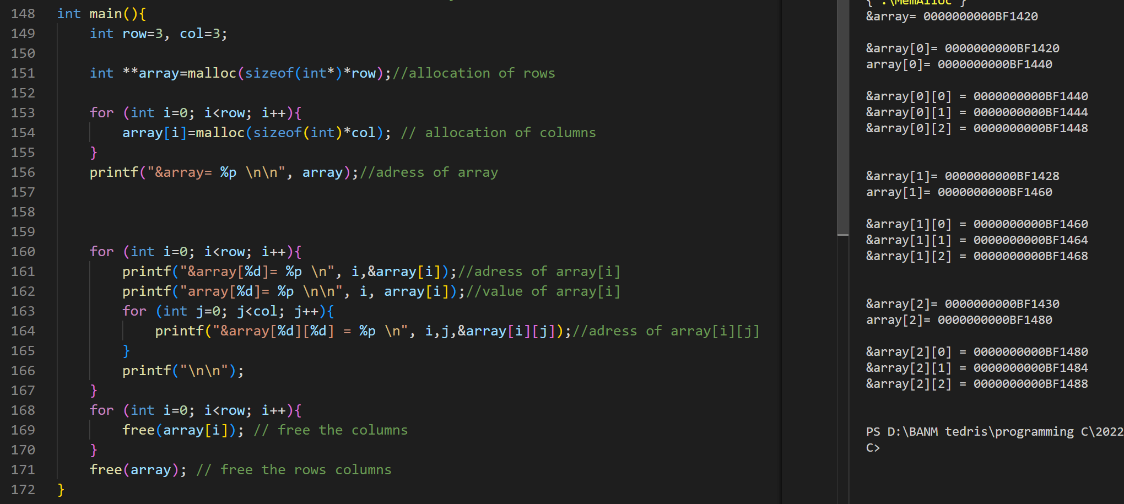
6. 7 allocation of 2d array
Notes:
int main(){
int row=3, col=3;
int **array=malloc(sizeof(int*)*row);//allocation of rows
for (int i=0; i<row; i++){
array[i]=malloc(sizeof(int)*col); // allocation of columns
}
printf("&array= %p \n\n", array);//adress of array
for (int i=0; i<row; i++){
printf("&array[%d]= %p \n", i,&array[i]);//adress of array[i]
printf("array[%d]= %p \n\n", i, array[i]);//value of array[i]
for (int j=0; j<col; j++){
printf("&array[%d][%d] = %p \n", i,j,&array[i][j]);//adress of array[i][j]
}
printf("\n\n");
}
for (int i=0; i<row; i++){
free(array[i]); // free the columns
}
free(array); // free the rows columns
}

Slide 15

References
Each Reference is indicated on the footer on each slide.
Books:
The_C_Programming_Language_(2nd_Edition_Ritchie_Kernighan)
Learn to Program with C_ Learn to Program using the Popular C Programming Language (Noel Kalicharan)
C How to Program, 8th edition, Paul Deitel and Harvey Deitel, Pearson, 2016.

Slide 16


Thank You
Nazrin Dolkhanova Sultanli
Nazrin.Sultanli.Dolkhanova@bhos.edu.az
Baku Higher Oil School

